Slide 1
Accessibility Testing
TechBash
November 2023
Erissa Duvall

Slide 2
Disclaimer:
While I may mention some examples from current/past jobs, I am not representing any of my employers during this presentation.
Additionally, while I will discuss some legislation, I am not a lawyer and nothing I say should be taken as definitive legal advice.
Confirm
Erissa

Slide 3
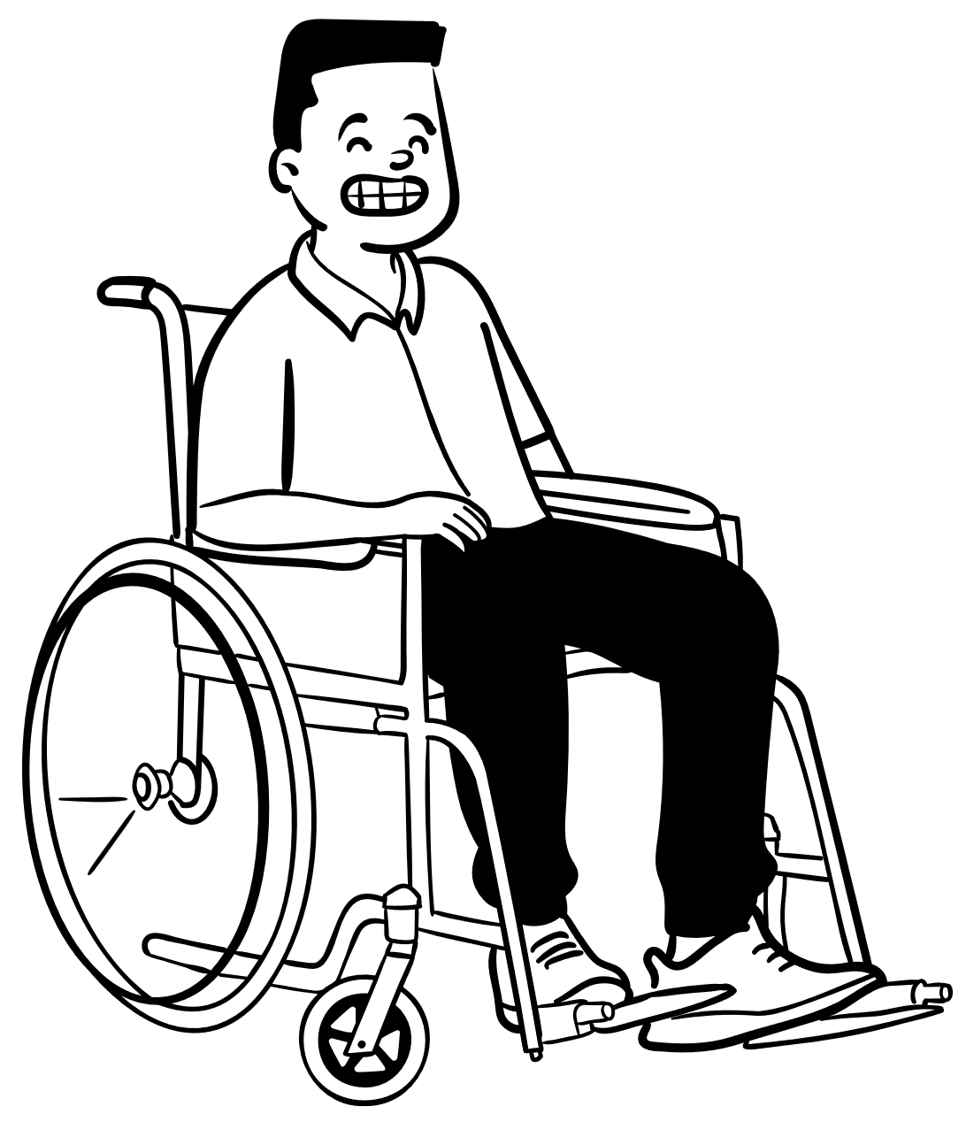
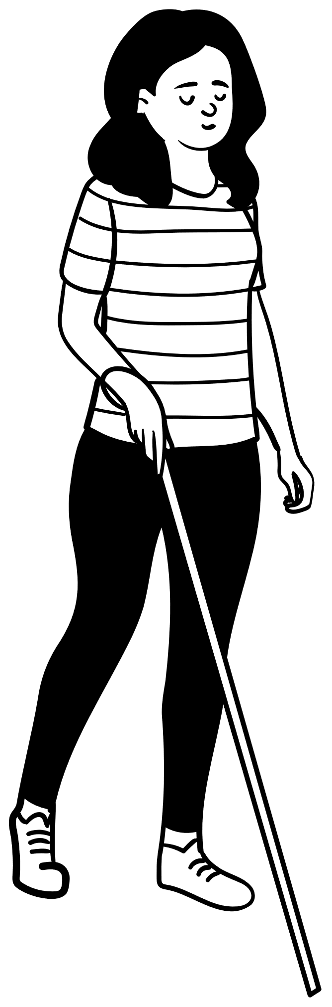
Overview
What is Accessibility?
What is Disability?
Why?
How to decide what is Accessible?
Building A11y Test Plans
Tools & Resources
Erissa

Slide 4
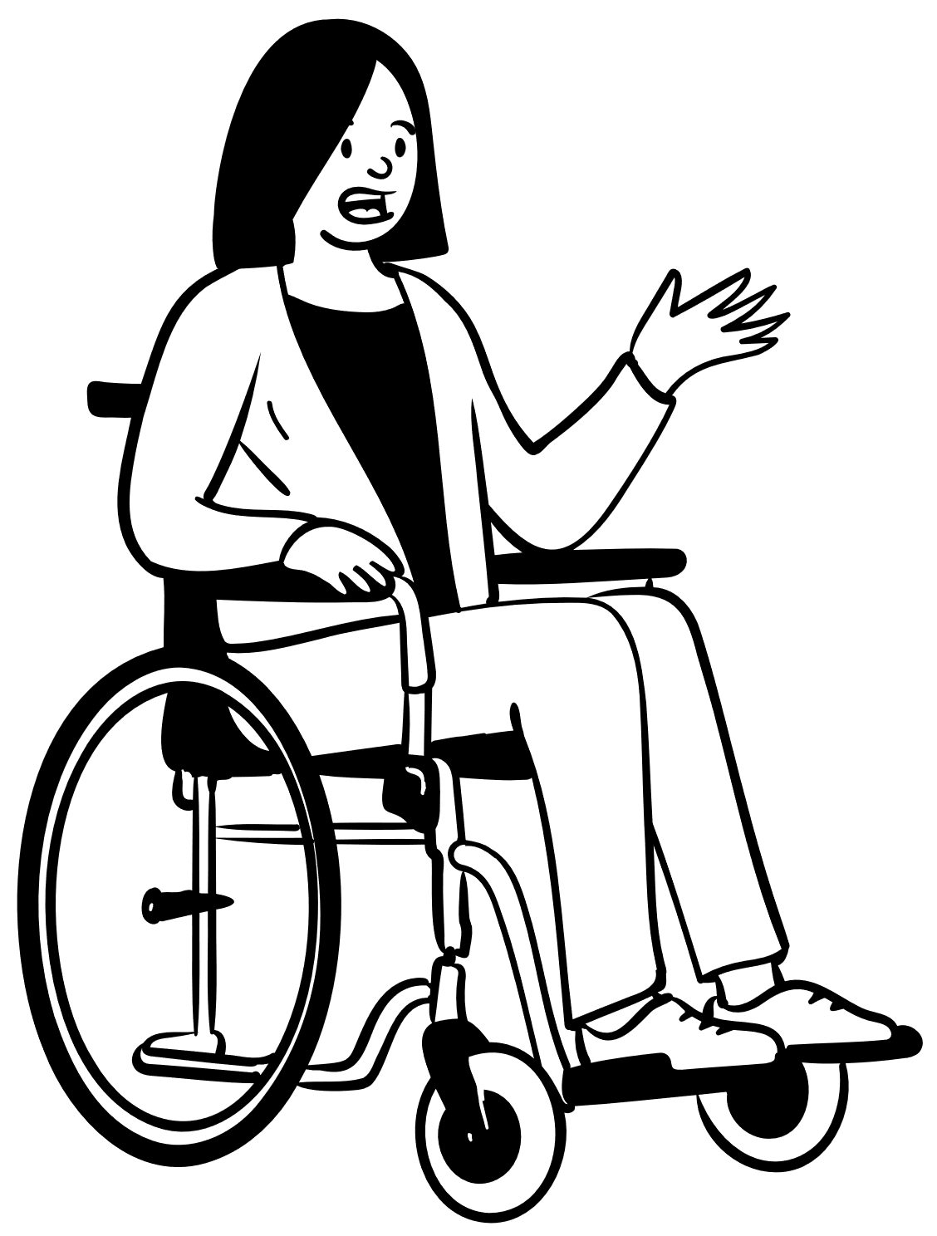
What is Accessibility?
Accessibility
Disability
Assistive / Adaptive Technology
Erissa
Notes:
Accessibility – how well can your product be used by people of all abilities?
Disability – A disability is basically a mismatch in interaction between a person’s body and the features of their environment in which they live.
Adaptive/Assistive Technology (AT) - is any item, piece of equipment, software program, or product that is used to increase, maintain, or improve the functional capabilities of people with disabilities.

Slide 5


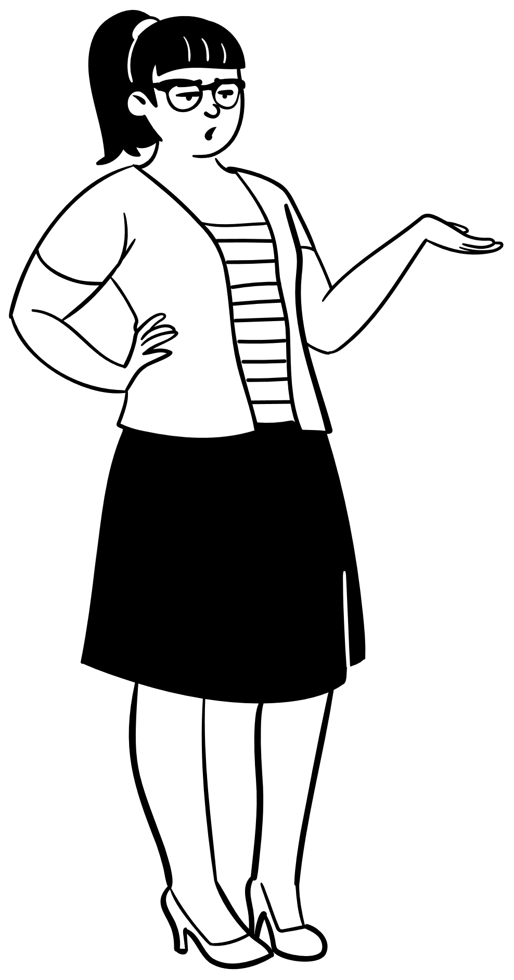
Why?
Accessibility helps to:
Remove barriers
Allow equal access
Through that we create an environment that:
Feels more welcoming
Encourages diversity
Helps people make informed decisions
Encouraging innovation / productivity / progress
Expand our market / audience
Erissa
Notes:
By creating an experience where people can all access the same information and services, we remove barriers. Through that help everyone:
make more informed choices for themselves and their communities
feel more welcome (employee/customer retention)
encourage diversity in our communities and workplaces
encourage innovation and progress
avoid missing out on the market
A Hidden Market: The Purchasing Power of Working-Age Adults With Disabilities | American Institutes for Research (air.org)
Article URL: https://www.air.org/resource/report/hidden-market-purchasing-power-working-age-adults-disabilities
`The total disposable income for U.S. adults with disabilities is about $490 billion, which is comparable to other significant market segments, such as African Americans ($501 billion) and Hispanics ($582 billion). (Disposable income is what is left after taxes are paid.); and Discretionary income for working-age people with disabilities is about $21 billion, which is greater than that of the African-American ($3 billion) and Hispanic ($16 billion) market segments, combined. (Discretionary income is the money remaining after deducting taxes, other mandatory charges, and spending on necessities, such as food and housing.”

Slide 6


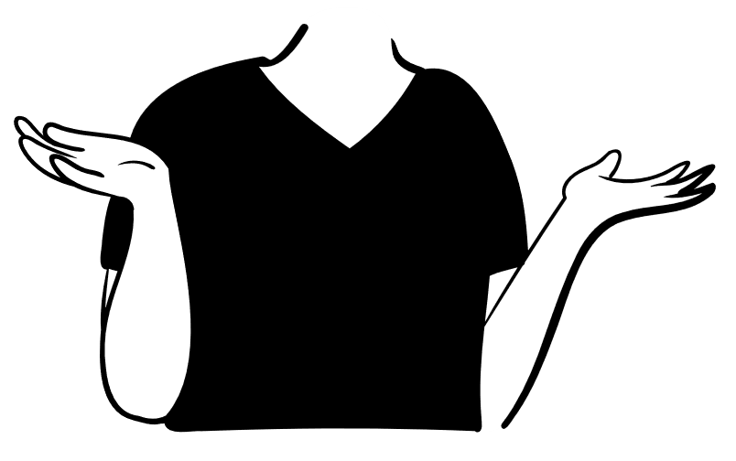
How to decide what is accessible
Guidelines
Web Content Accessibility Guidelines (WCAG)
Accessible Electronic Documents Community of Practice (AED COP)
Regulations
Americans with Disabilities Act (ADA)
Section 508 of the Rehabilitation Act of 1973 (USA)
Section 255 of the Communications Act (USA)
Learn more at: Web Accessibility Laws & Policies | WAI | W3C
Experience
User Feedback
Erissa

Slide 7
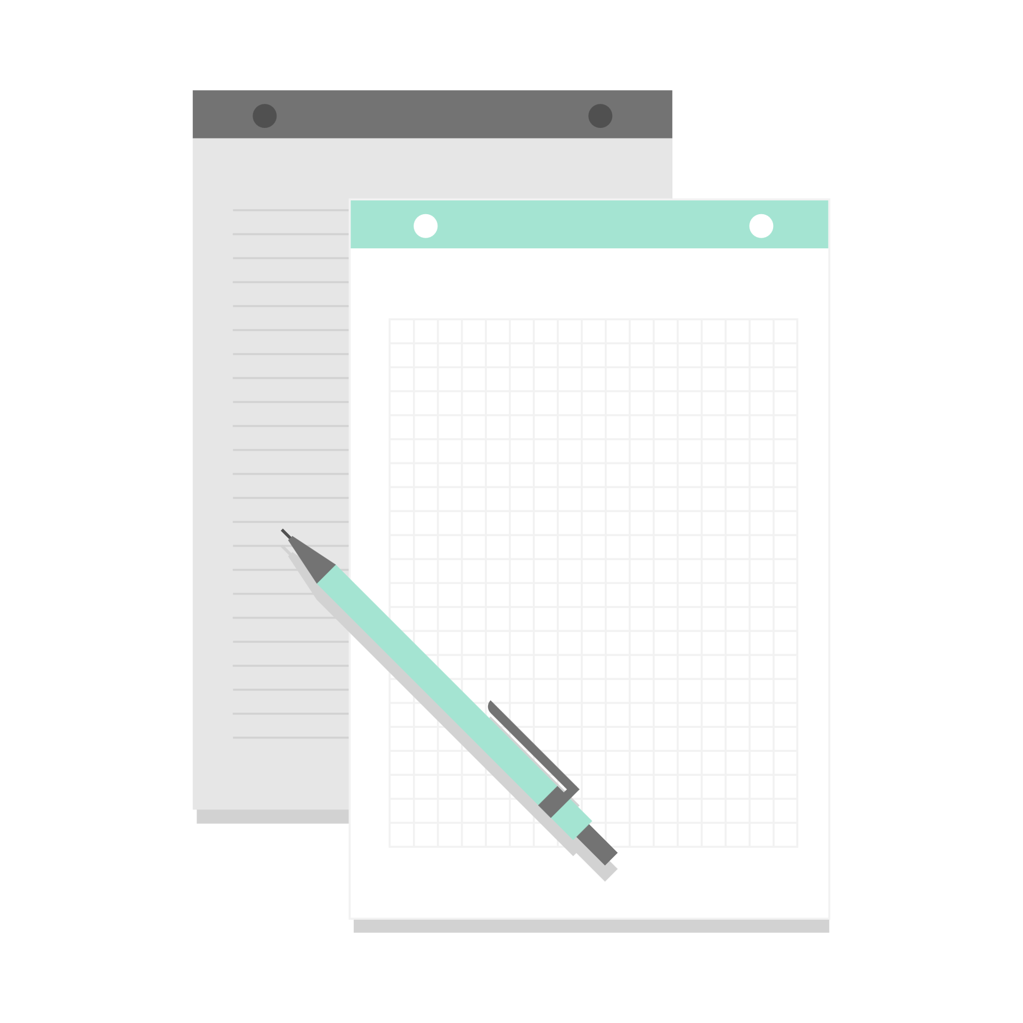
Building A11y Test Plans
Shift left
WCAG foundation
Manual and Automated
Nothing without us
Screen reader and Keyboard accessible
browsers
Customize test methods for different environments:
Desktop, Mobile, Mobile Web, Native App
Chrome, Firefox, Edge, or other
Erissa
Notes:
Example Test Methods/Plans:
VGAR – Visa Global Accessibility Requirements
Section 508 ICT Testing Baseline for Web

Slide 8
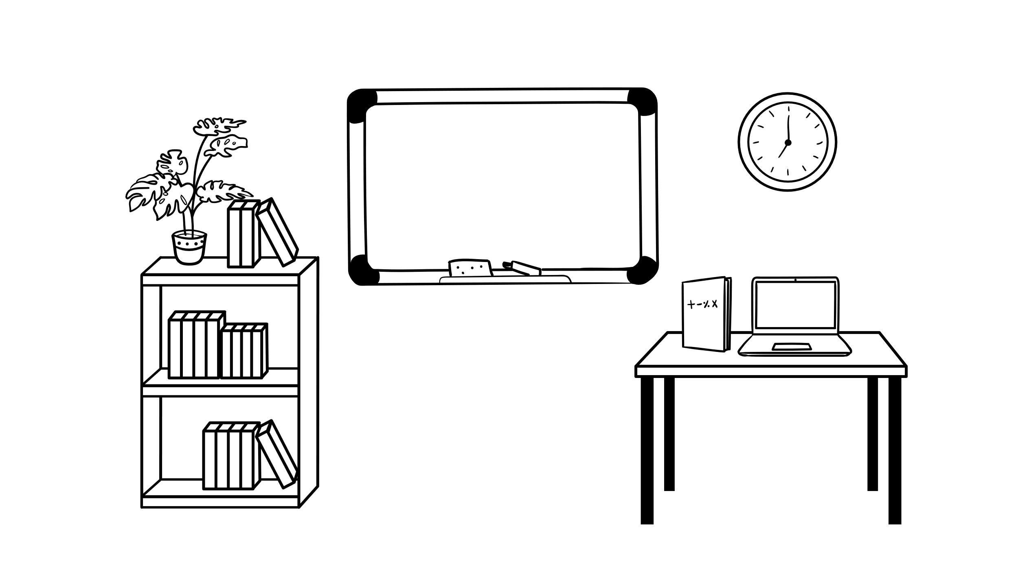
Tools & Resources
Built into your Operating Systems (OS) (MacOS & Windows)
Built into your Browser (Edge & Firefox)
Desktop Applications
Browser Extensions & Web Apps
Bookmarklets
Books
Additional Resources
Erissa

Slide 9
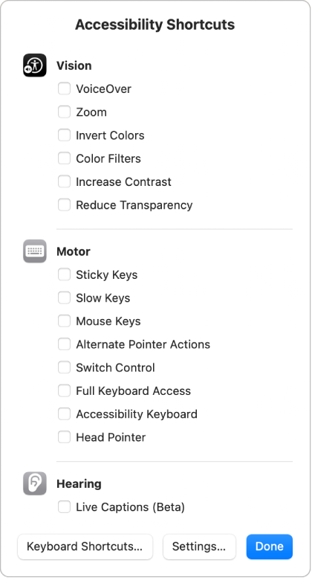
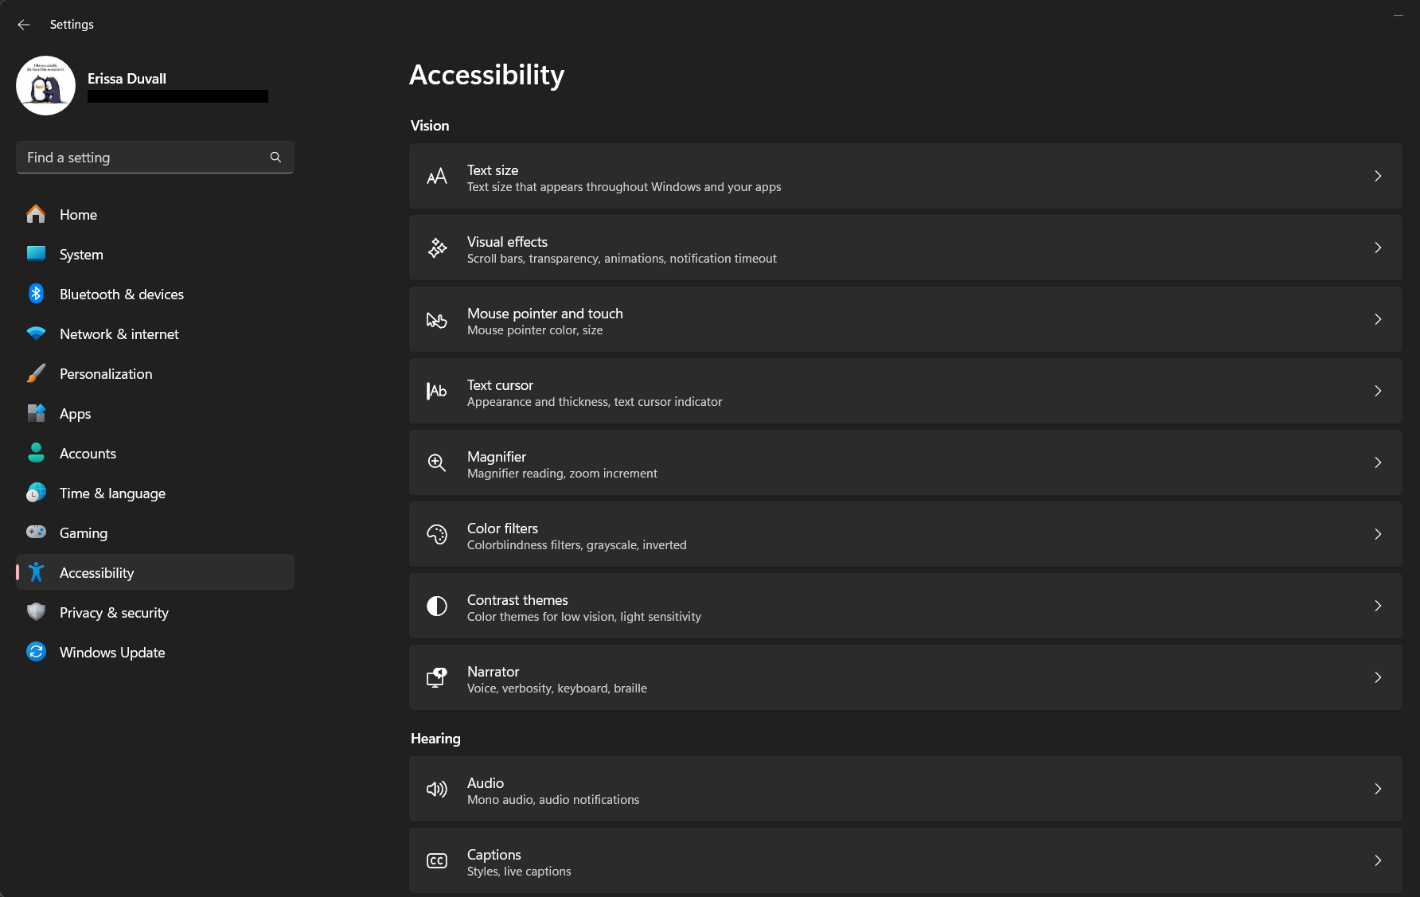
Built into OS
Erissa
Notes:
Microsoft and MacOS have a variety of built in accessibility options that help you zoom, have narration, use color filters and more to make a system more accessible based on your needs or test for accessibility in your content.
Additionally, there are keyboard shortcuts that help you turn accessibility features on/off quickly as needed.

Slide 10
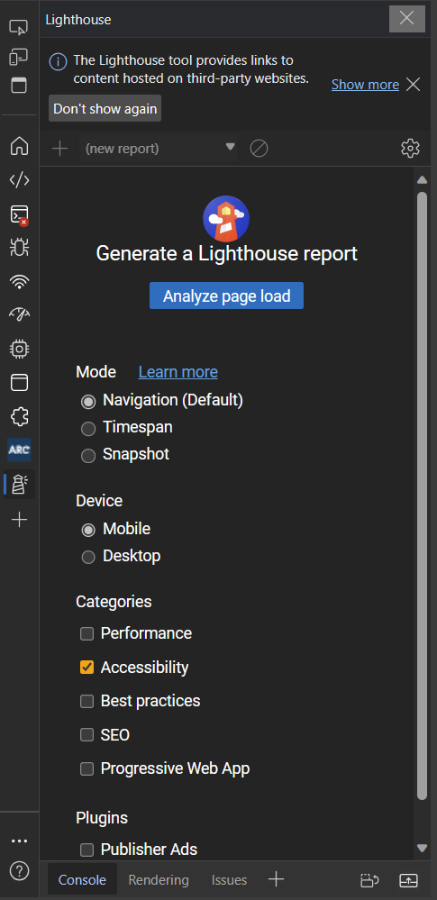
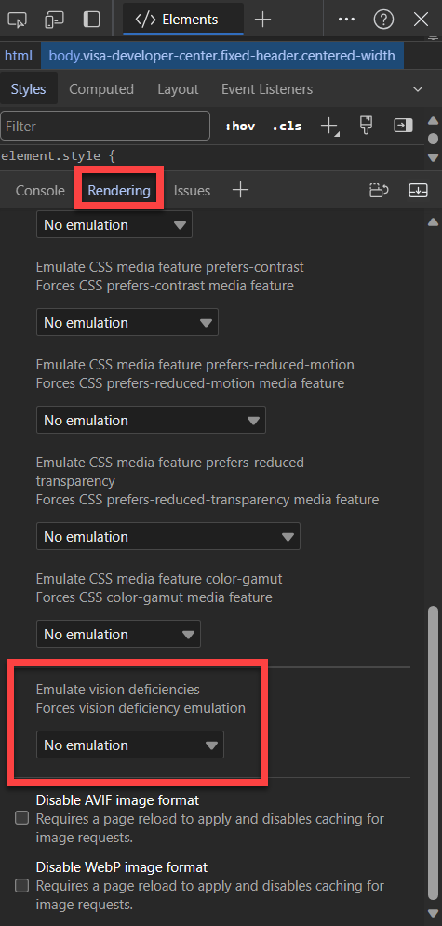
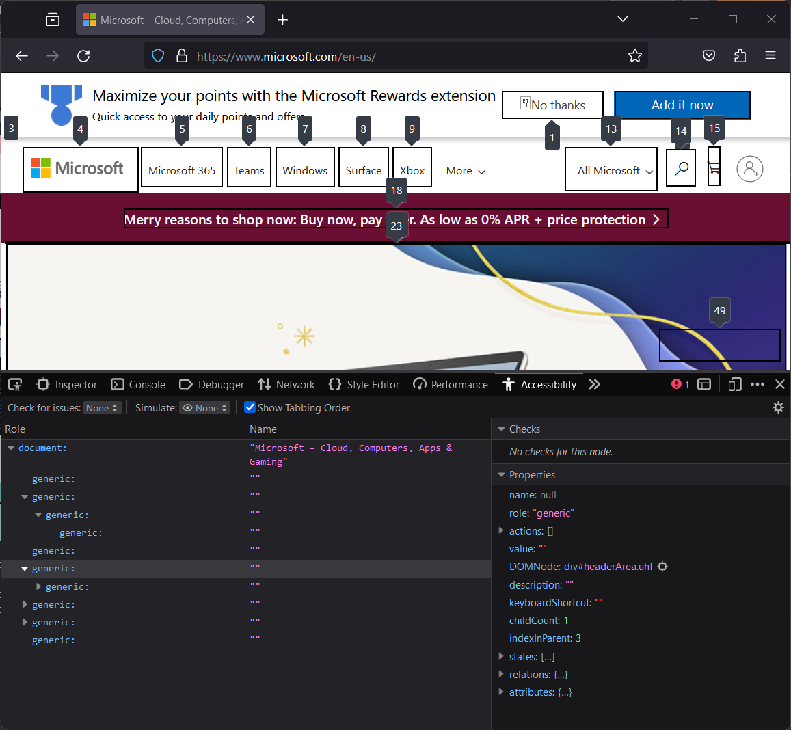
Built into Browsers
start
Notes:
Lighthouse is built into Chromium based browsers like Google Chrome and Microsoft Edge. It allows you to check Accessibility, SEO, and performance impacting elements of a page.
Firefox has similar options, but they are separated out into individual scanners, rather than under one option.
The rendering options are also built into Chromium browsers. They allow you to get an idea for how some disabilities may view your page and see how various custom CSS options may impact your site appearance and behavior.

Slide 11
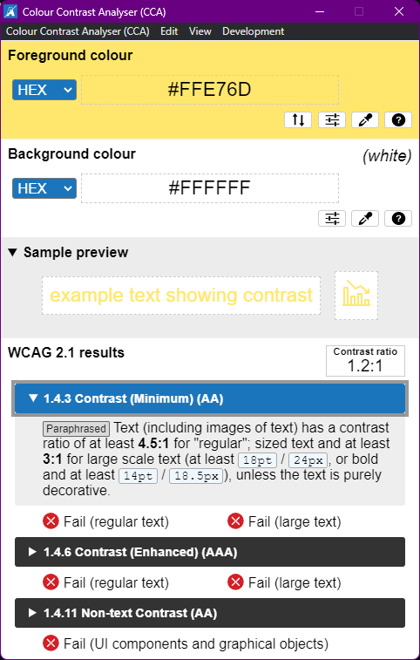
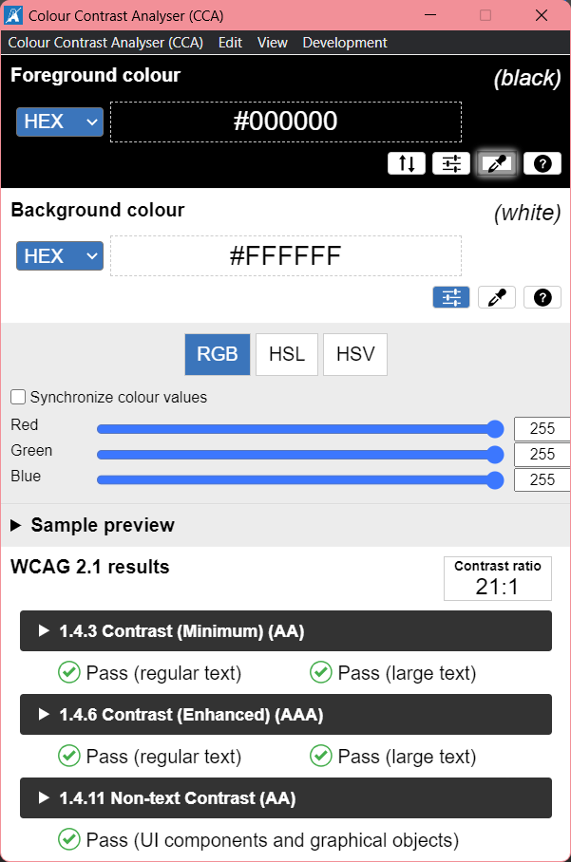
Desktop Applications
start
Notes:
Color Contrast Analyzer by TPGi - https://www.tpgi.com/color-contrast-checker/

Slide 12
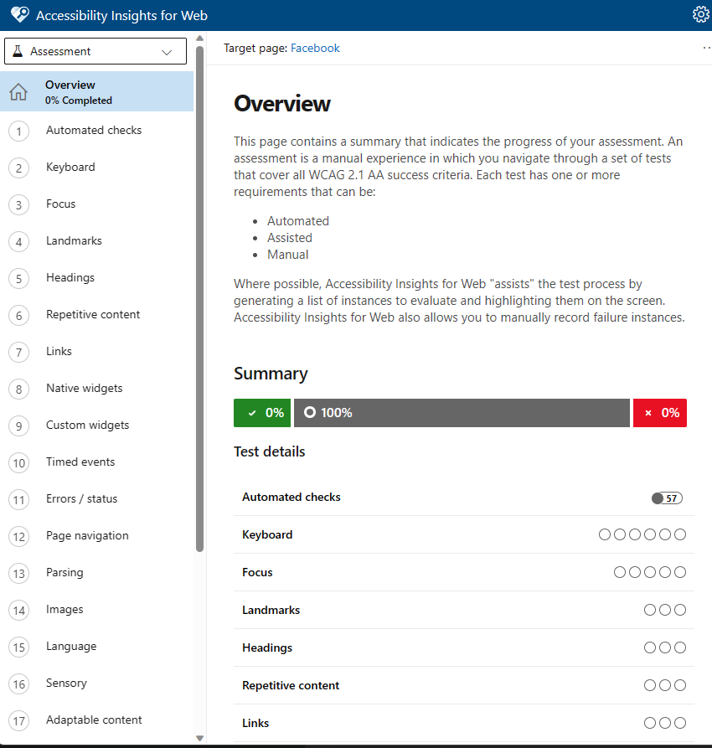
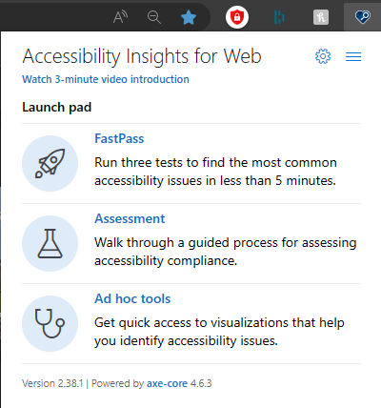
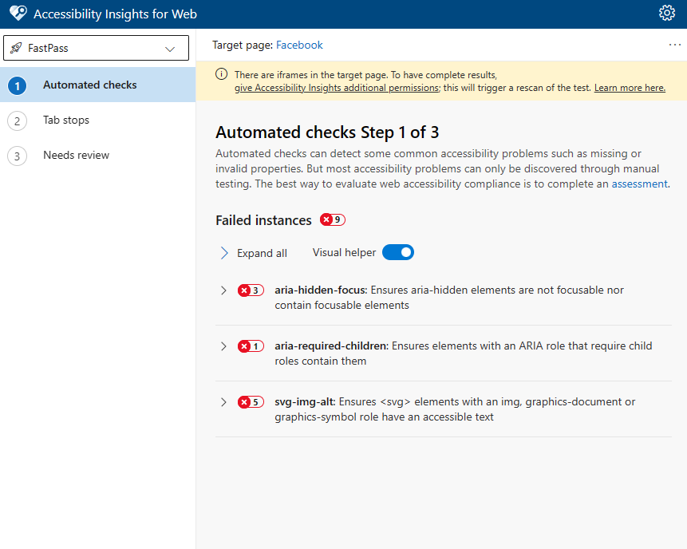
Microsoft Accessibility Insights
Erissa
Notes:
Accessibility Insights is an open-source application developed by Microsoft and based off Axe Core.

Slide 13
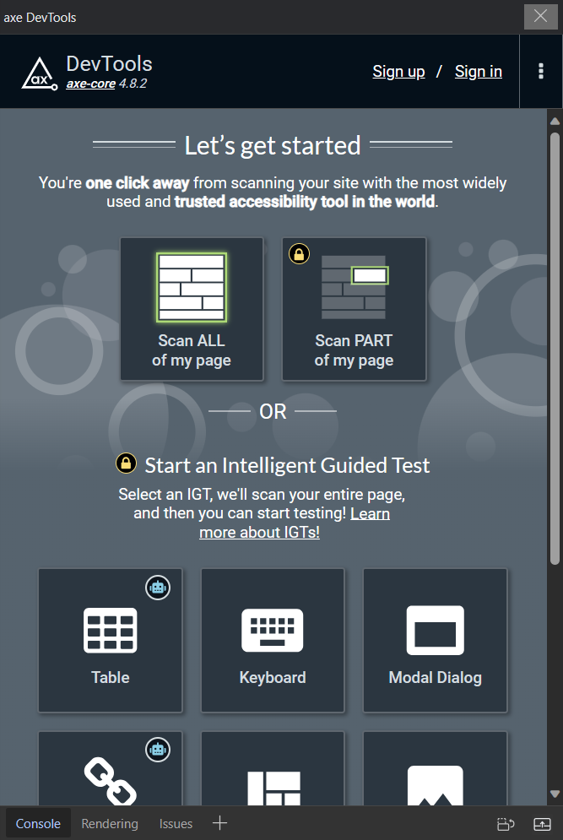
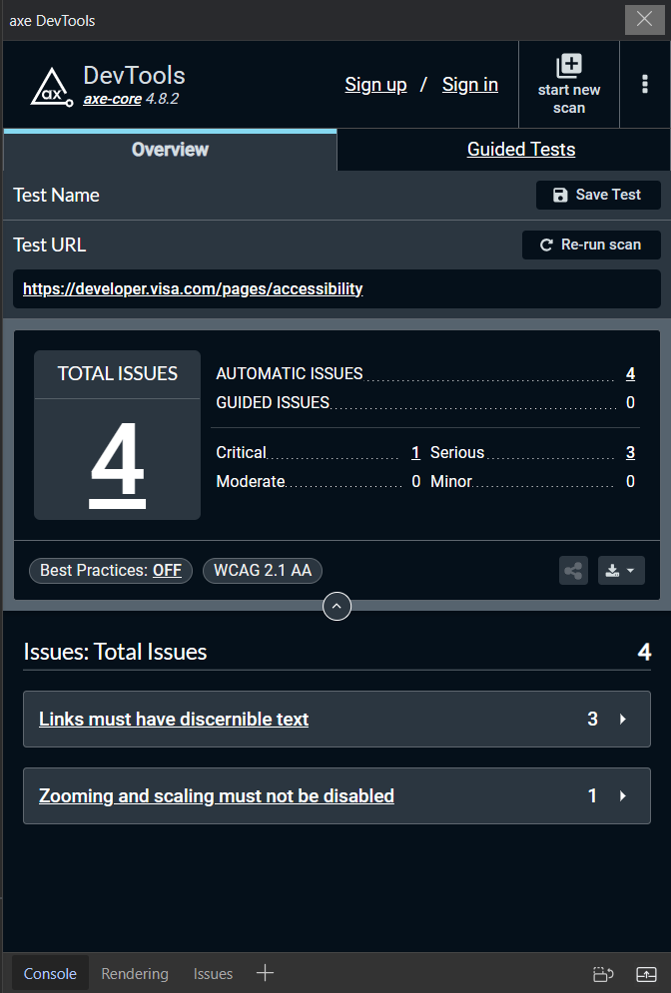
Deque Axe DevTools
Erissa
Notes:
Axe DevTools (Can use forever for free. Pro just offers some extra testing features.) - https://www.deque.com/axe-devtools-accessibility-testing/

Slide 14
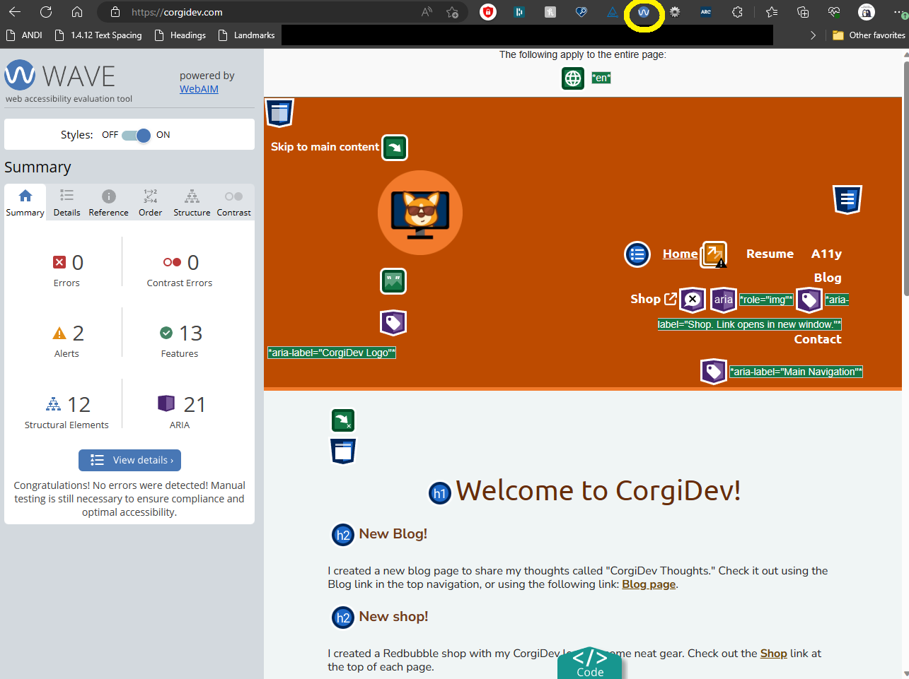
WAVE
Erissa
Notes:
WAVE Chrome, Firefox, and Edge Extensions (webaim.org): https://wave.webaim.org/extension/

Slide 15
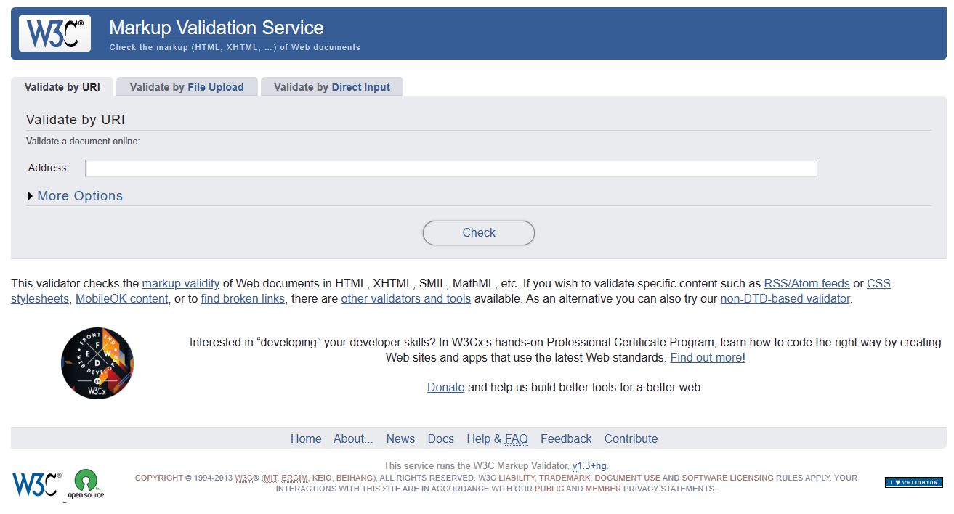
W3C Markup Validation Service
Erissa
Notes:
The W3C Markup Validation Service - https://validator.w3.org/

Slide 16
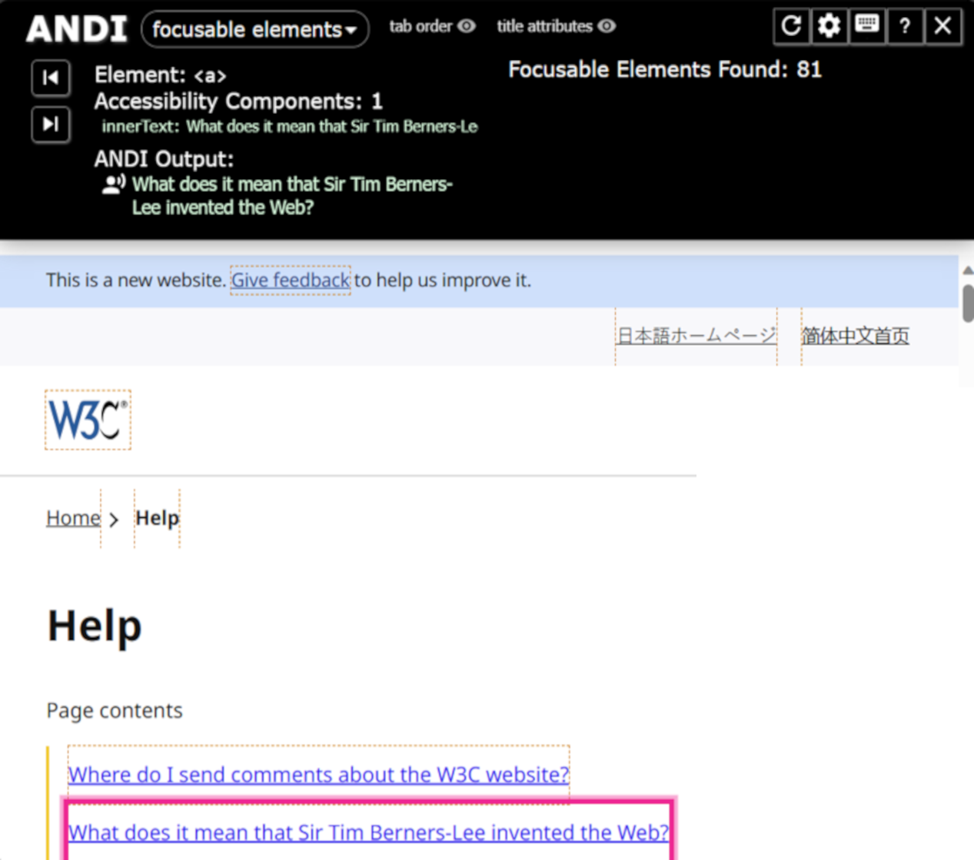
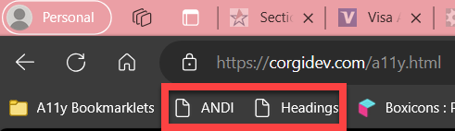
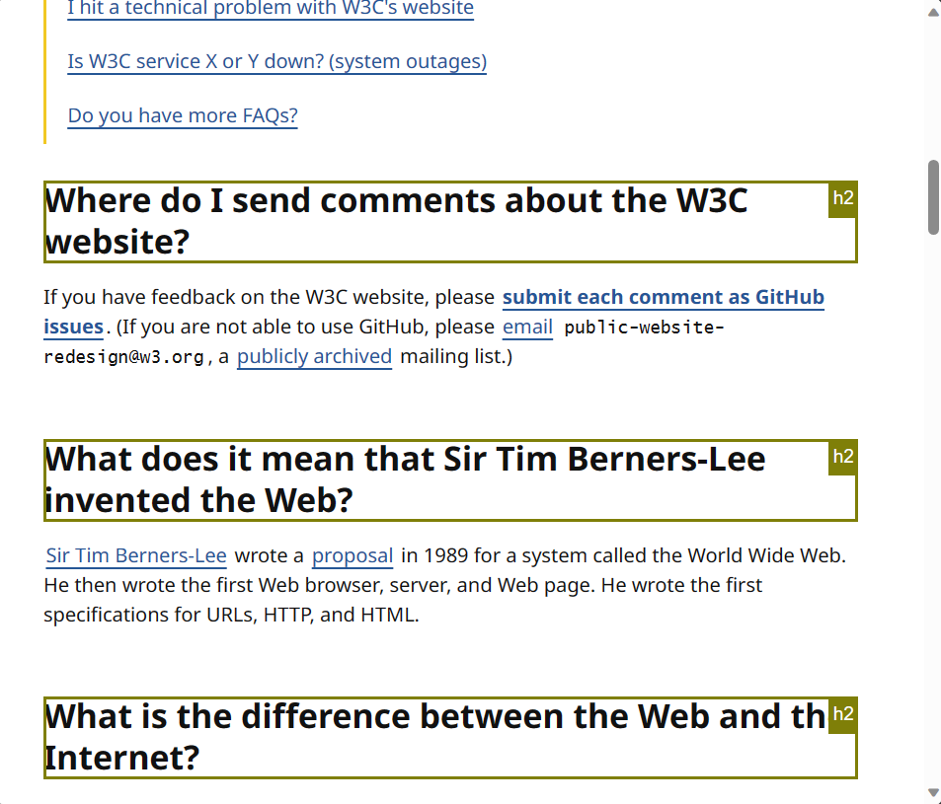
Bookmarklets
Landmarks Bookmarklet | HolisticA11Y
Forms Bookmarklet (pauljadam.com)
ARIA Bookmarklet (pauljadam.com)
Text Spacing Bookmarklet (dylanb.github.io)
Accessibility Bookmarklets (accessibility-bookmarklets.org)
ANDI Accessibility Testing Tool (ssa.gov)
Erissa

Slide 17
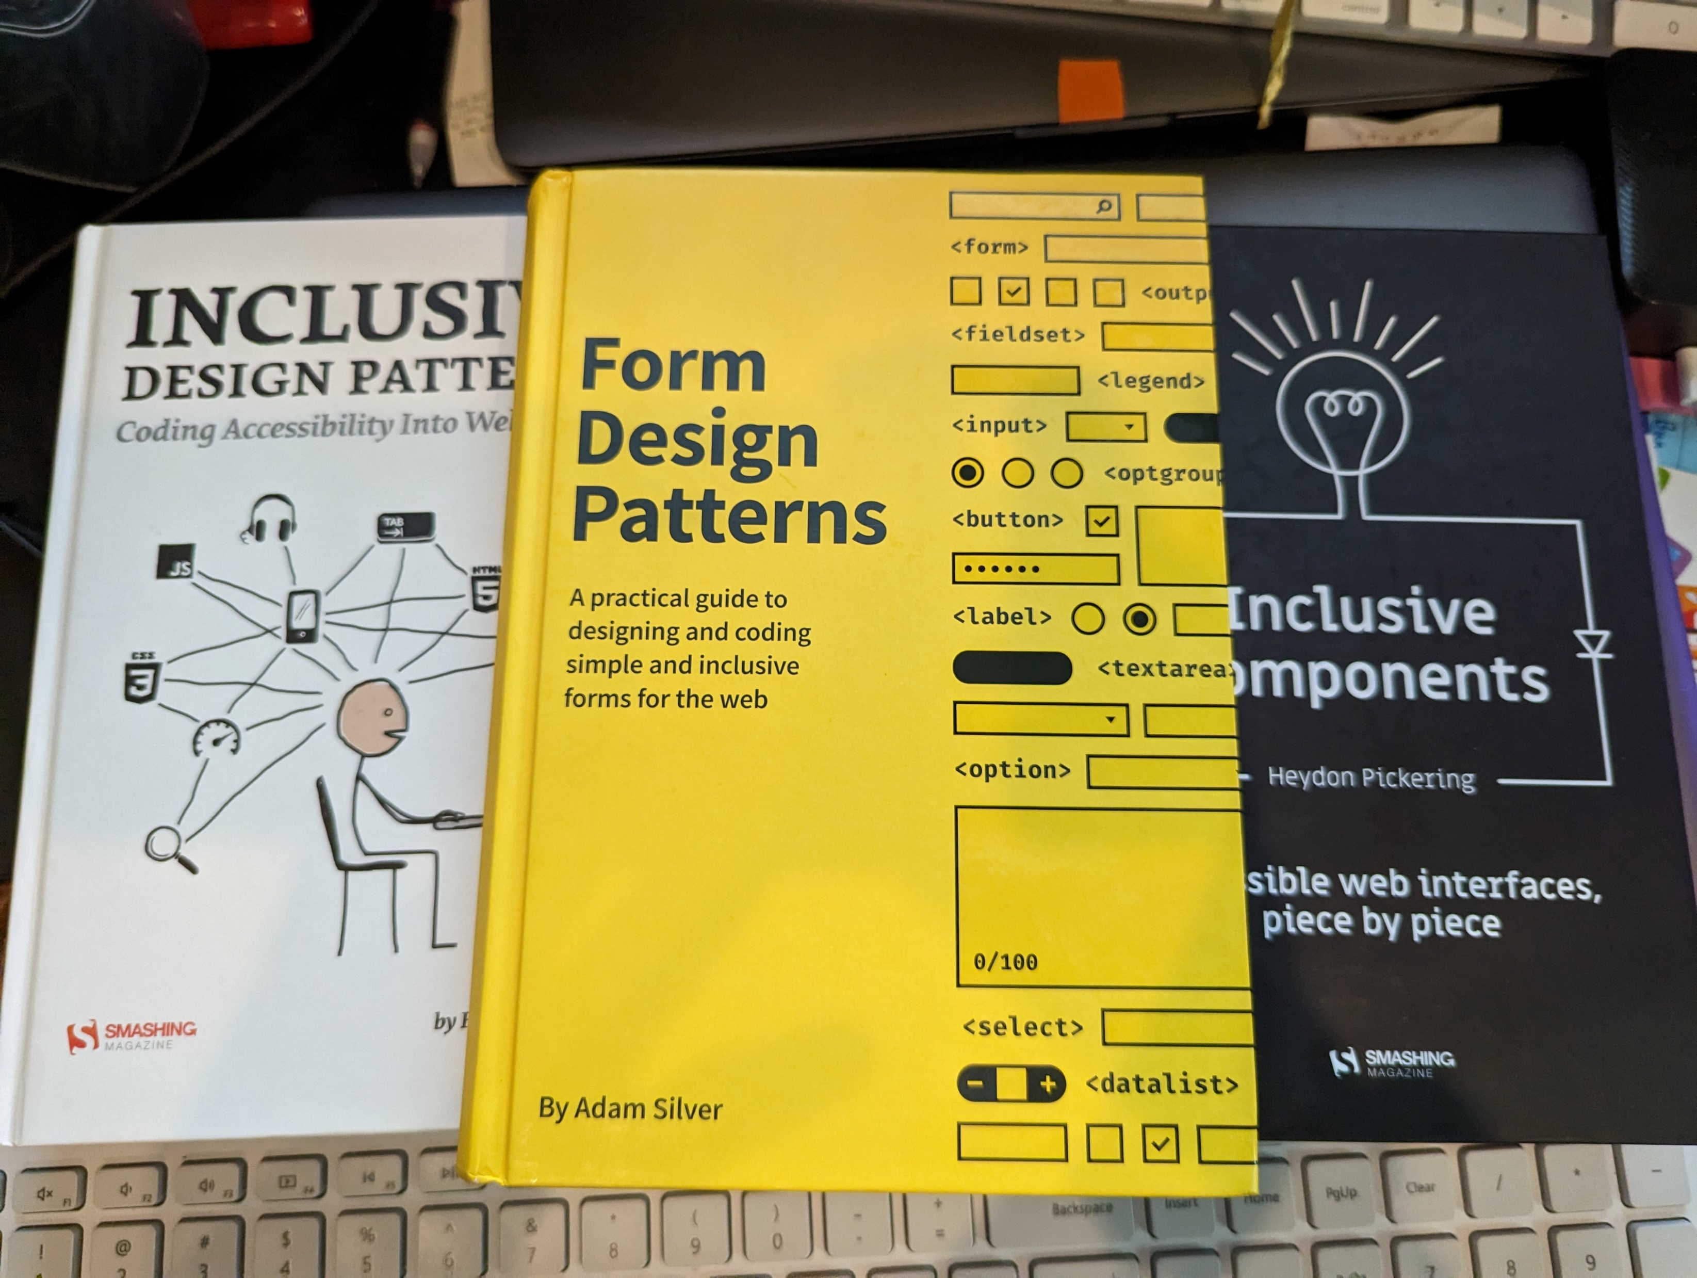
Books
"Inclusive Design Patterns" by Heydon Pickering
"Form Design Patterns" by Adam Silver
"Inclusive Components" by Heydon Pickering.
Erissa

Slide 18
Additional Resources
Accessibility Insights – Accessibility testing tool made by Microsoft
Has browser extension and desktop application versions
Also have the option to include the automated tests in CI/CD
DON’T depend on automated tests
Screen reader
NVDA – free, open-sourced screen reader
View keyboard shortcuts on at the Deque article entitled: NVDA Keyboard Shortcuts.
Narrator – screen reader built-in to Windows.
View keyboard shortcuts for Narrator in the Deque article entitled Narrator Keyboard Shortcuts.
VoiceOver – is a built screen reader found on iOS and MacOS devices.
TalkBack – is a built screen reader found on iOS and MacOS devices.
Microsoft Accessibility on Twitter at @MSFTEnable and at on the Microsoft Accessibility page.
Microsoft Accessibility Fundamentals course
ANDI – Bookmark applet developed by the Social Security Administration to aid in Accessibility testing.
Erissa

Slide 19
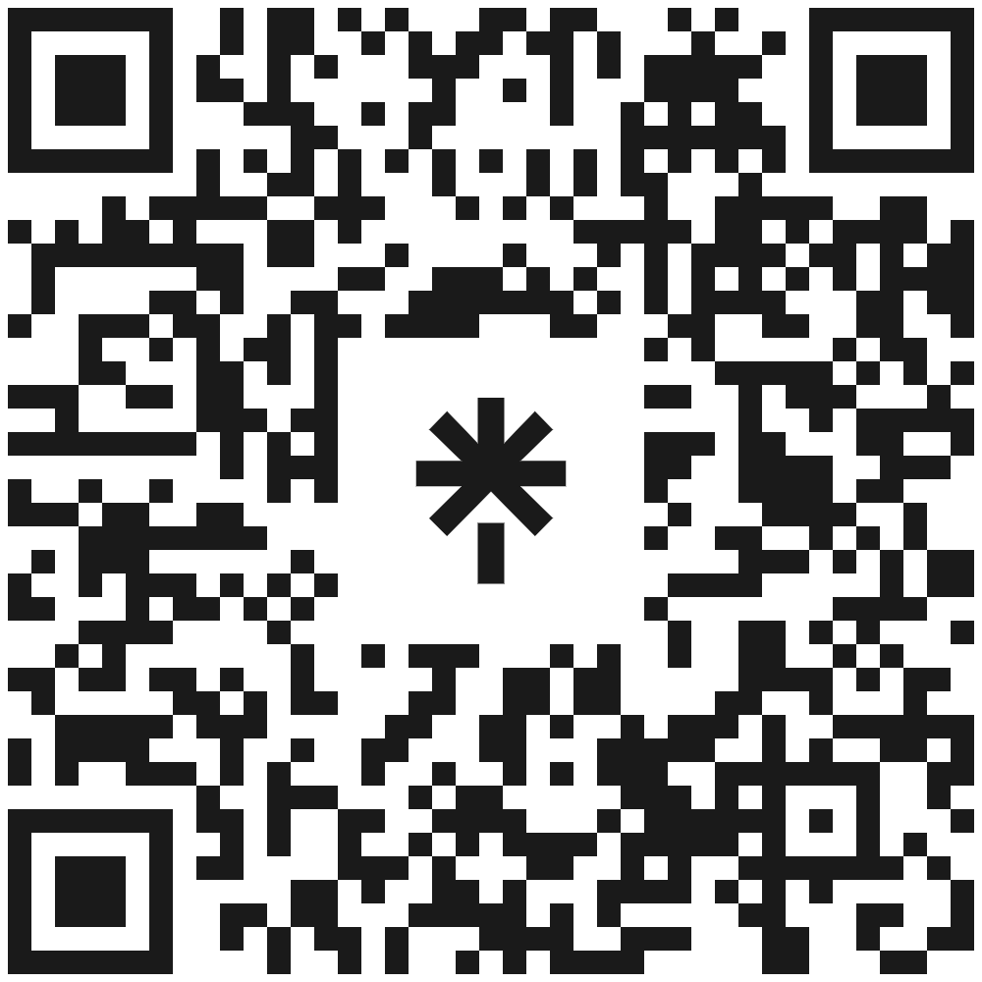
Thank You!
linktr.ee/corgidev
Questions?
Erissa

